Slide 1
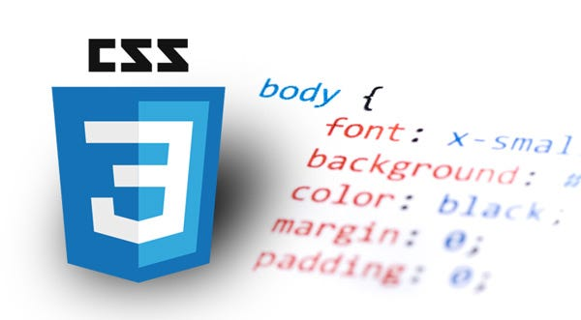

CSS
Cascading Stylesheet

Slide 2
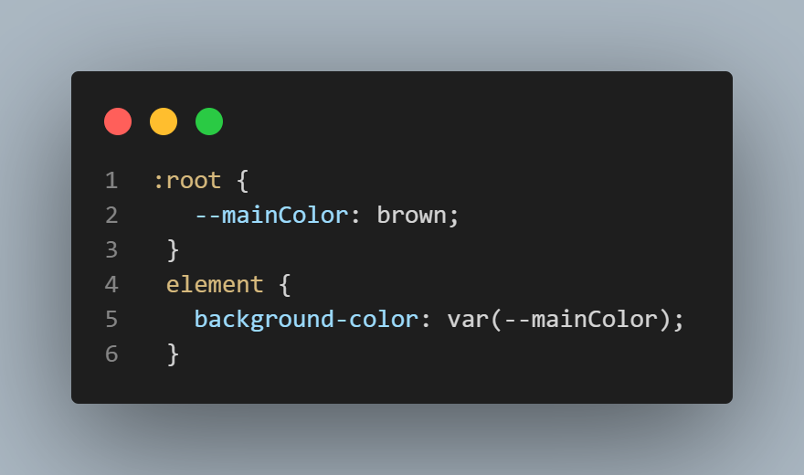
Variables and Custom Properties
Custom properties (CSS variables) are entities that contain specific values to be reused throughout a document.
Declaring a custom property is done using a custom property name that begins with two dashes (--), and a property value that can be any valid CSS value. and are accessed using the var() function.
Note: Custom property names are case sensitive. --my-color will be treated as a separate custom property to --My-color.

Slide 3
Scope of CSS variables
We can declare CSS variables with local and global scopes.
Global variables can be accessed/used through the entire document, while local variables can be used only inside the selector where it is declared.
To create a variable with global scope, declare it inside the :root selector.
The :root selector matches the document's root element.
To create a variable with local scope, declare it inside the selector that is going to use it.

Slide 4
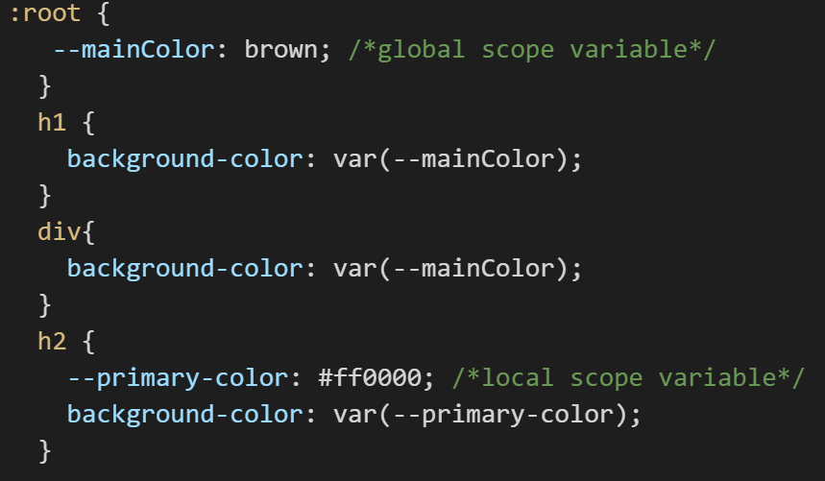
Scope of CSS variables

Slide 5
Variables and Custom Properties
What is benefit of using Custom Properties? Type in chat!
Using custom properties in CSS promotes code reuse, modularity, maintainability, and flexibility, enabling you to create more efficient and robust stylesheets.

Slide 6
Animations in CSS

Slide 7
Creating Animations in CSS
An animation lets an element gradually change from one style to another.
You can change as many CSS properties you want, as many times as you want.
To use CSS animation, you must first specify some keyframes for the animation.
Keyframes hold what styles the element will have at certain times
To get an animation to work, you must bind the animation to an element.

Slide 8
Creating Transition in CSS

Slide 9
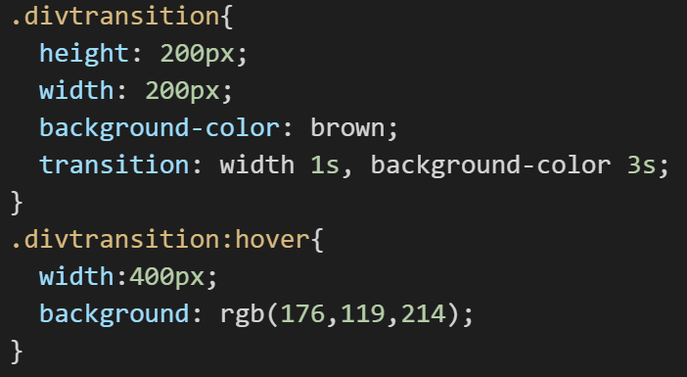
Transition in CSS
With CSS Transition we can change property values smoothly over a given duration.
To create a transition effect, you must specify two things:
CSS property you want to add an effect to
Duration of the effect (must have a value greater than 0)

Slide 10
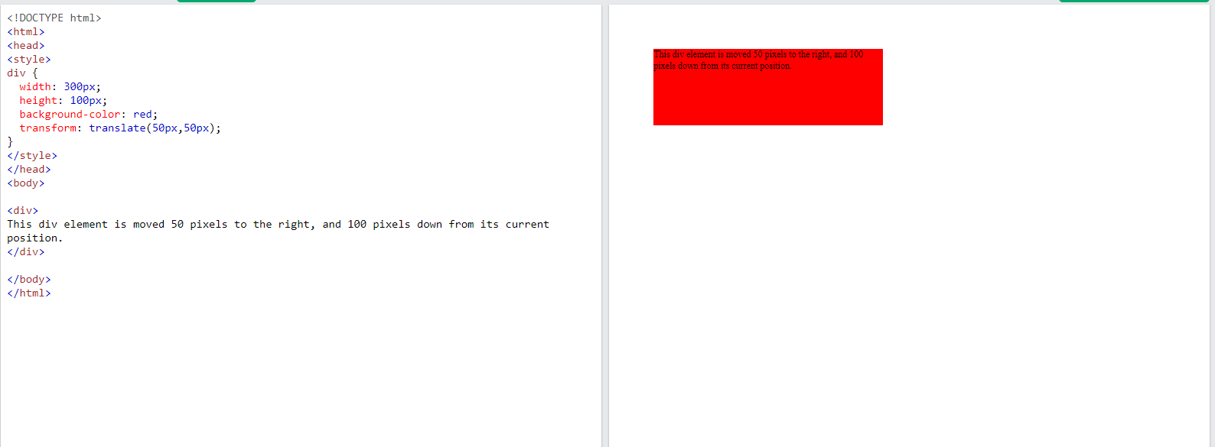
CSS transform property
CSS transforms allow you to move, rotate, scale, and skew elements.
The translate() method moves an element from its current position
Will push the div 50px from left and 50px from top
Note: for moving element from bottom to top and from right to left, use negative values

Slide 11
CSS transform property
The rotate() method rotates an element

